Slide 1
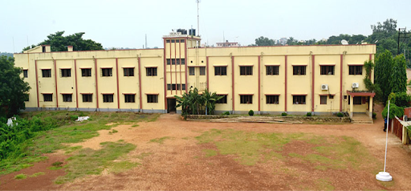
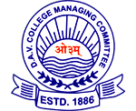
DAV PUBLIC SCHOOL, MIDNAPORE
Name: - Sambhav Agarwal
Class: - XI (Science)
Section: - B Roll: - 27
Subject: - English
Topic: - Musical Instruments of
Bengal and Ladakh

Slide 2

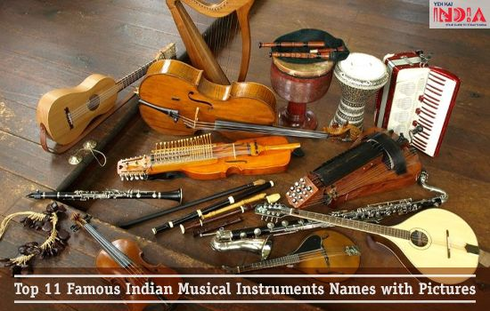
MUSICAL
INSTRUMENTS OF BENGAL

Slide 3
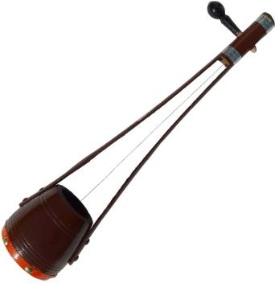
Ektara
Ektara literally 'one-string‘, is a one-stringed musical instrument used in the traditional music of South Asia, and used in modern-day music of Bangladesh, India. It originated in South Asia.
In origin the ektara was a regular string instrument of wandering bards and minstrels from India and is plucked with one finger. The ektara is a drone lute consisting of a gourd resonator covered with skin, through which a bamboo neck is inserted. It is used in parts of India and Nepal today by Yogis and wandering holy men to accompany their singing and prayers. In Nepal, the instrument accompanies the singing of the Ramayana and Mahabharata.

Slide 4
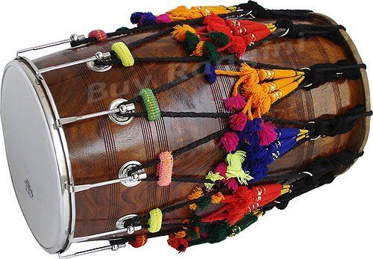
Dhol
Dhol can refer to any one of a number of similar types of double-headed drum widely used, with regional variations, throughout the Indian subcontinent. Its range of distribution is India, Bangladesh and includes northern areas of India. The range stretches westward as far as eastern Afghanistan. A related instrument is the dholak or dholki. Someone who plays the dhol is known as dholi.

Slide 5
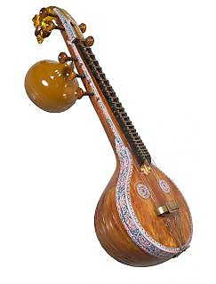
Veena
The Veena is an Indian plucked string instrument. Also known as raghunatha veena, it is used mostly in Carnatic Indian classical music. There are several variations of the veena, which in its South Indian form is a member of the lute family. One who plays the veena is referred to as a vainika. The Saraswati veena is one of major types of veena today. The others include chitra veena, vichitra veena and rudra veena. Out of these the rudra and vichitra veenas are used more often in Hindustani music, while the Saraswati veena and the chitra veena are used more frequently in the Carnatic music of South India.

Slide 6
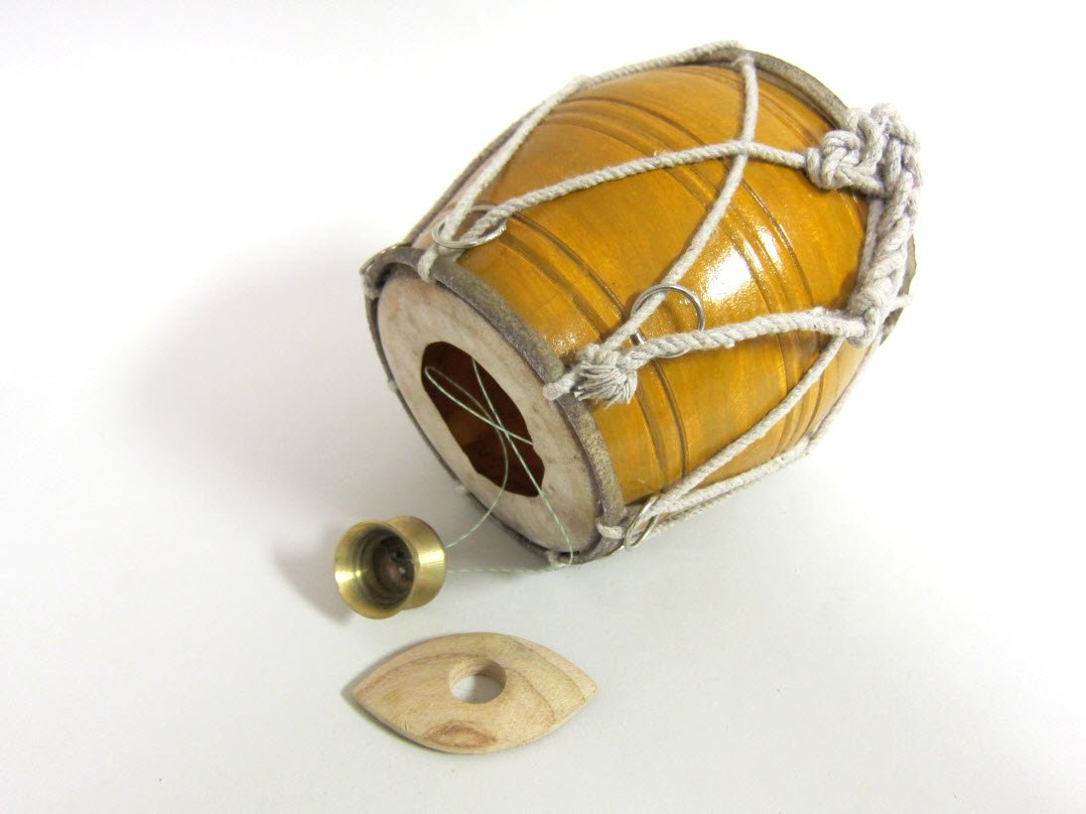
Khamak
The Khamak is a string instrument close to ektara, originating in India, common in folk music of Bengal, Odisha and North East India, especially Baul gan. It is a one-headed drum with a string attached to it which is plucked.
The Khamak consists of three basic parts. A bowl which is often made out of wood is connected by several strings to another, smaller piece (also usually made out of wood). The bowl is held under the arm holding the smaller piece in the hand of same arm. Finally, the string are plucked by the other hand while adjusting the tension of strings creating the desired sound. It is generally used in Bengali folk songs. It is one of the most ancient string instruments in eastern India.

Slide 7
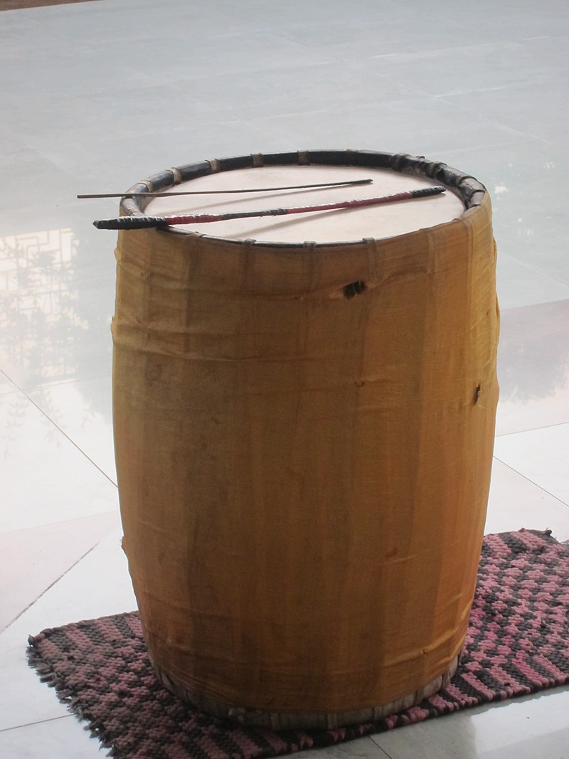
Dhak
The Dhak is a huge membranophone instrument from India. The shapes differ from the almost cylindrical to the barrel. The manner of stretching the hide over the mouths and lacing also varies. It suspended from the neck, tied to the waist and kept on the lap or the ground, and usually played with wooden sticks. The left side is coated to give it a heavier sound.
Drum beats are an integral part of Durga Puja.It is mostly played by the Bengali Hindu community.
The Statesman wrote, "Durga Puja does not assume the festive aura without the maddening beats of the dhak, the large drum that men hang around their necks and play with two thin sticks to infuse the frenzied rhythm into listeners. Those enchanting beats are enough to conjure up the sights and smells of Durga Puja."

Slide 8
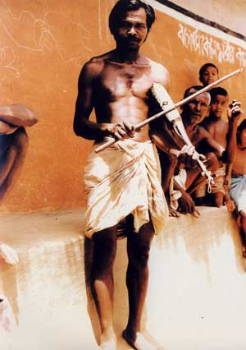
Banam
The banam is an ancient fiddle like instrument played by the Santals. Of the 14 different instruments they play, the banam, is the most revered. The Santals play this generally one-stringed instrument as an accompaniment to their songs and dances like the Dasae, Sohrae, Don, Lagre and Karam.

Slide 9
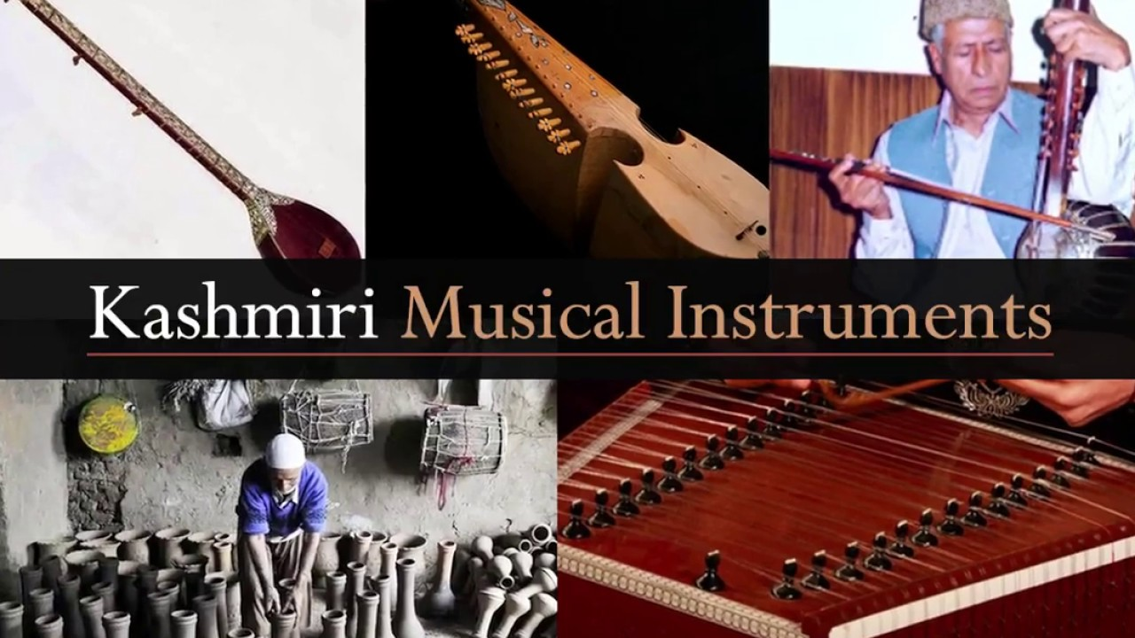
Musical
Instruments of Ladakh

Slide 10
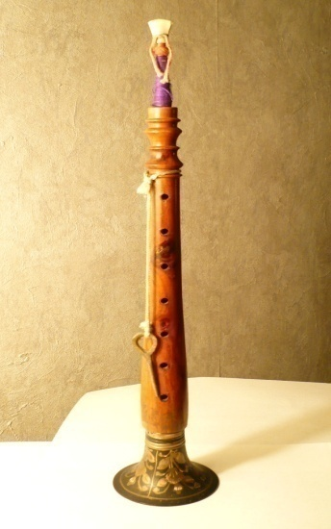
Sorna
The sornā or Sarnā (also Surna and Zurna) is an ancient Iranian woodwind instrument.
Possibly it was called "strong flute" due to its double-reed-construction rather than usual nāy, which was made of a single tube of cane. Also it is suggested that the first part of word of sorna, is from sūr- again from Pahlavi and New-Persian, meaning the "banquet, meal and feast", thus the "banquet-flute".
It is also suggested that "Sorna" is a cognate of "Horn", as "Sorna" simply means horn. This is a result of the Centum-Satem isogloss, and later Grimm's Law. Even in Persian there is another wind instrument whose name appears to be a cognate of both "Sorna" and "Horn", called "Karna".

Slide 11
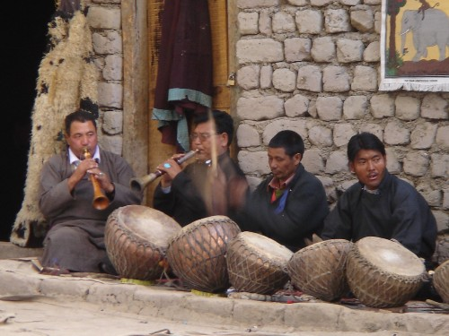
Damau
Damau (also damaun, dhamu or dhmuva) is a single-headed drum instrument that is played extensively in the folk music of Uttarakhand in India. It is usually played along with the larger drum, the dhol, according to the ancient oral treatise of Dhol Sagar, which lists specific rhythm patterns for every occasion in life, including christening, wedding, religious festivals, folk drama and death rituals.

Slide 12
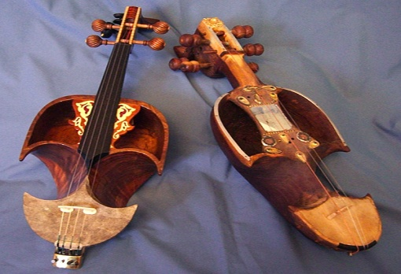
Piwang
A string instrument made from willow or apricot wood and has similarities with the violin. Piwang is very popular among the nomadic people who live with their herds in the high Changthang plateau and is played with their popular dance called Jabro.

Slide 13
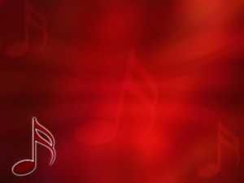
Thank You

